Slide 1
BOX PLOTS AND VIOLIN PLOTS DEPARTMENT OF DATA SCIENCE
C.Revanth
21691A3278
Data visualization

Slide 2
BOX PLOTS
The box- and –whisker plot was first introduced in 1970 by “JOHN TUKEY”, Exploratory Data Analysis
A box plot is standardized way of displaying the dataset based on the five-number summary.
In descriptive statistics, a box plot is a method for graphically demonstrating the locality, spread and skewness group of numerical data through their quartiles
Applications:
The outliers and their values
Symmetry of data
Tight grouping of data
Data skewness – if , in which direction and how

Slide 3
FIVE-NUMBER SUMMARY
Minimum (Q₀ or 0th percentile): the lowest data point in the data set excluding any outliers
First quartile (Q₁ or 25th percentile): it is the median of the lower half of the dataset.(N+1) /4
Median (Q₂ or 50th percentile): the middle value in the data set .(N+1)/2
Third quartile (Q₃ or 75th percentile): it is the median of the upper half of the dataset. ^{(3(N+1)/4}
Maximum (Q₄ or 100th percentile): the highest data point in the data set excluding any outliers

Slide 4
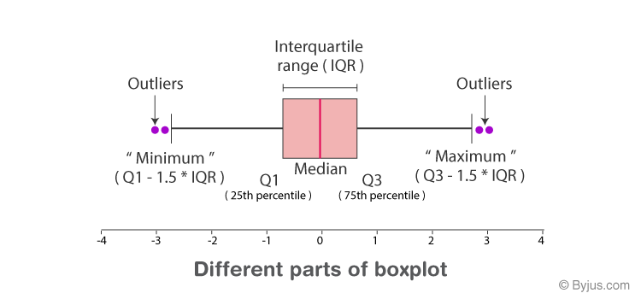
Interquartile range = Q3-Q1
Minimum = Q1 – 1.5*IQR
Maximum = Q3 +1.5 *IQR
Outliers are greater than Q3 and less than Q1

Slide 5
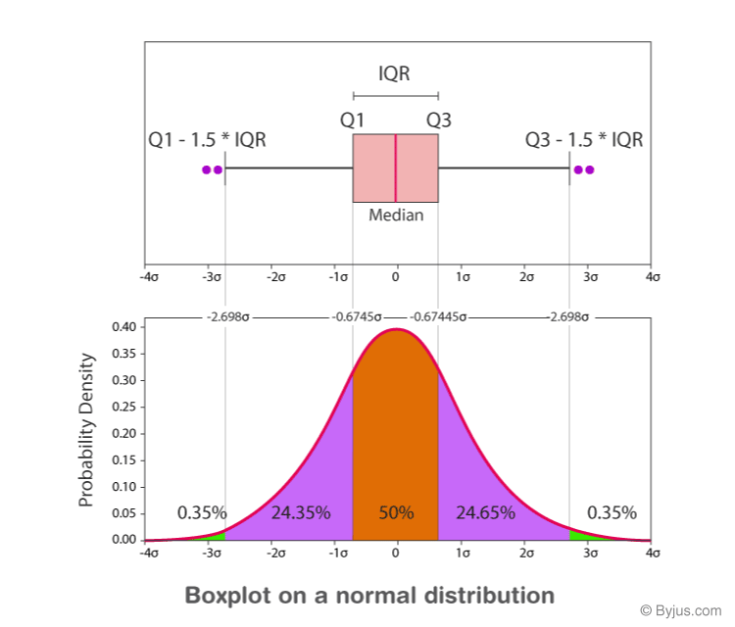

Slide 6
BOX PLOT EXAMPLE:
Find the maximum, minimum, median, first quartile, third quartile for the given data set: 23, 42, 12, 10, 15, 14, 9.
Solution:
Given: 23, 42, 12, 10, 15, 14, 9.
Arrange the given dataset in ascending order.
9, 10, 12, 14, 15, 23, 42
Hence,
Minimum = 9
Maximum = 42
Median = 14
First Quartile = 10 (Middle value of 9, 10, 12 is 10)
Third Quartile = 23 (Middle value of 15, 23, 42 is 23).

Slide 7
Syntax
seaborn.boxplot(data=None, *, x=None, y=None, hue=None, order=None, hue_order=None, orient=None, formatter=None, legend='auto', ax=None, **kwargs)

Slide 8
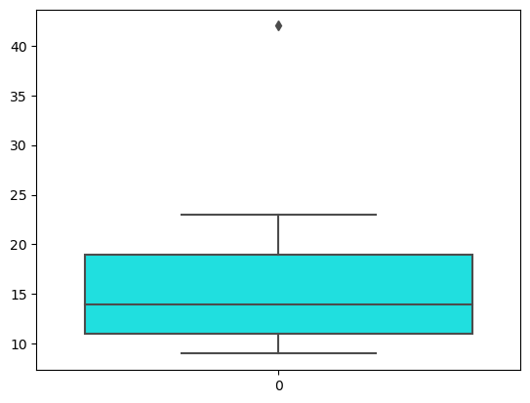
Example:
from matplotlib import pyplot as plt
import seaborn as sns
Data=[23, 42, 12, 10, 15, 14, 9]
sns.boxplot(data=Data,color=‘cyan’)
plt.show()

Slide 9
VIOLIN PLOT
visualizes the distribution of numerical data
combination of a box plot and a kernel density plot
The box plot shows summary statistics, while the kernel density plot shows peaks in the data.
Applications:
Visualize the distribution of data and its probability density
Show summary statistics and the density of each variable
Use density curves to indicate distributions of numeric data for one or more sets
Portray the frequency of data points in each region by the width of each curve
Visualize changes in distributions over time or space

Slide 10
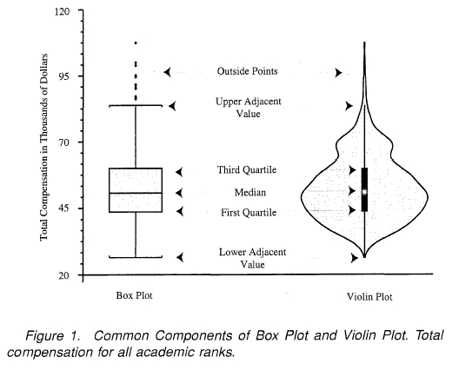

Slide 11
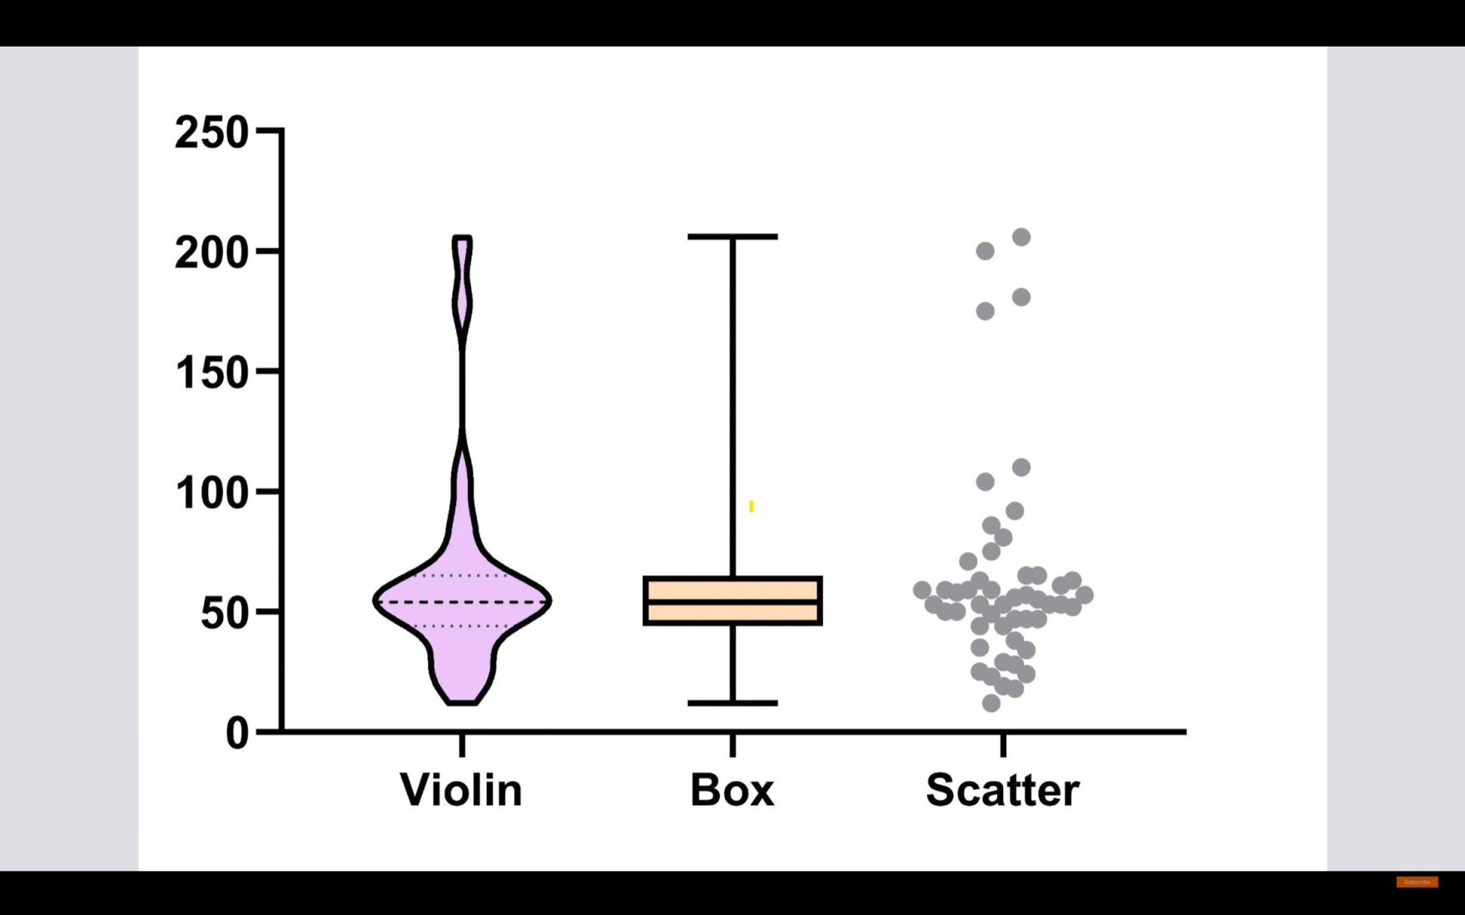

Slide 12
Syntax
seaborn.violinplot(data=None, *, x=None, y=None, hue=None, order=None, hue_order=None, orient=None, color=None, palette=None, saturation=0.75, bw=<deprecated>, inner_kws=None, ax=None, **kwargs)

Slide 13
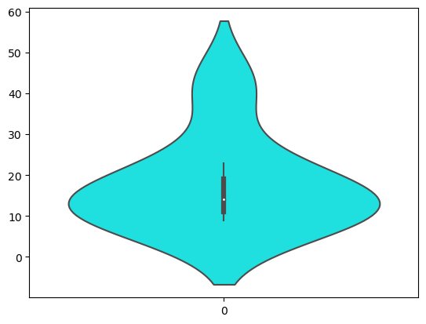
Example
From matplotlib import pyplot as plt
Import seaborn as sns
Data=[23, 42, 12, 10, 15, 14, 9]
Sns.violinplot(data=Data)
Plt.show()

Slide 14
Difference between box plot and violin plot
Box plot and Violin plot are two common types of graphical representations used for visualizing continuous data.
BOX PLOT:
A box plot gives a summary of the five-number summary of the data while ignoring the distributional shape
It is more useful when comparing the distribution of data between different groups
A box plot is better suited for a larger dataset, because it’s easy to compare many groups at once
VIOLIN PLOT:
A Violin plot shows the shape of the distribution of the data, along with the summary statistics
It is useful when we want to see the full picture of the data distribution, and also compare distributions between groups
Violin plots can be more effective for smaller datasets

Slide 15
SUMMARY
In summary, both boxplots and violin plots are used to represent the distribution of data, but their design and interpretation differ in the way they display the distribution shape of the data.
Box plots are more useful for comparing the distribution between different groups
Violin plots are better suited for understanding the full picture of the data distribution

Slide 16
THANK YOU

